Slide 1

University Healthcare Database System
Section 1
Group 14
Aarushi Sharma
Aniket Sakharkar

Slide 2



Business Problem
When a student walks in, a doctor may not have the time to go through mountains of data. As a result, the information must be queried, filtered, and retrieved using the appropriate technology.
Universities across the United States are planning to create a database system to address the problem with the respective university’s healthcare database, where students must fill out the student health history form, and the data is stored not only in the university’s record but also the hospital based on the zip code that each student enters. As needed, students can seek medical attention and receive the necessary vaccinations based on their previous records.
If a student needs the assistance of medical professionals from other facilities, a database system enables information interchange to be in place. With this university healthcare database system, the centre will be able to retrieve easily, update, and report patient data, assisting medical professionals and doctors in providing prompt, accurate diagnoses.

Slide 3
Business Requirements
Officials will need to log in with their respective university login credentials to access their University's Healthcare Database in addition to the details of the nearby healthcare service providers, depending on their location and zip code.
With the help of the details provided by the students, vaccination providers can also set up how many vaccinations would be needed per university in the upcoming days/months.
A student can fill out multiple forms to report any condition or update in their medical history, which will be updated in the database system against their previous instance.
Healthcare providers who are no longer affiliated with the organization and whom the students may have named on the medical form will not have access to the database, demonstrating the various levels of security that this database system will have.

Slide 4
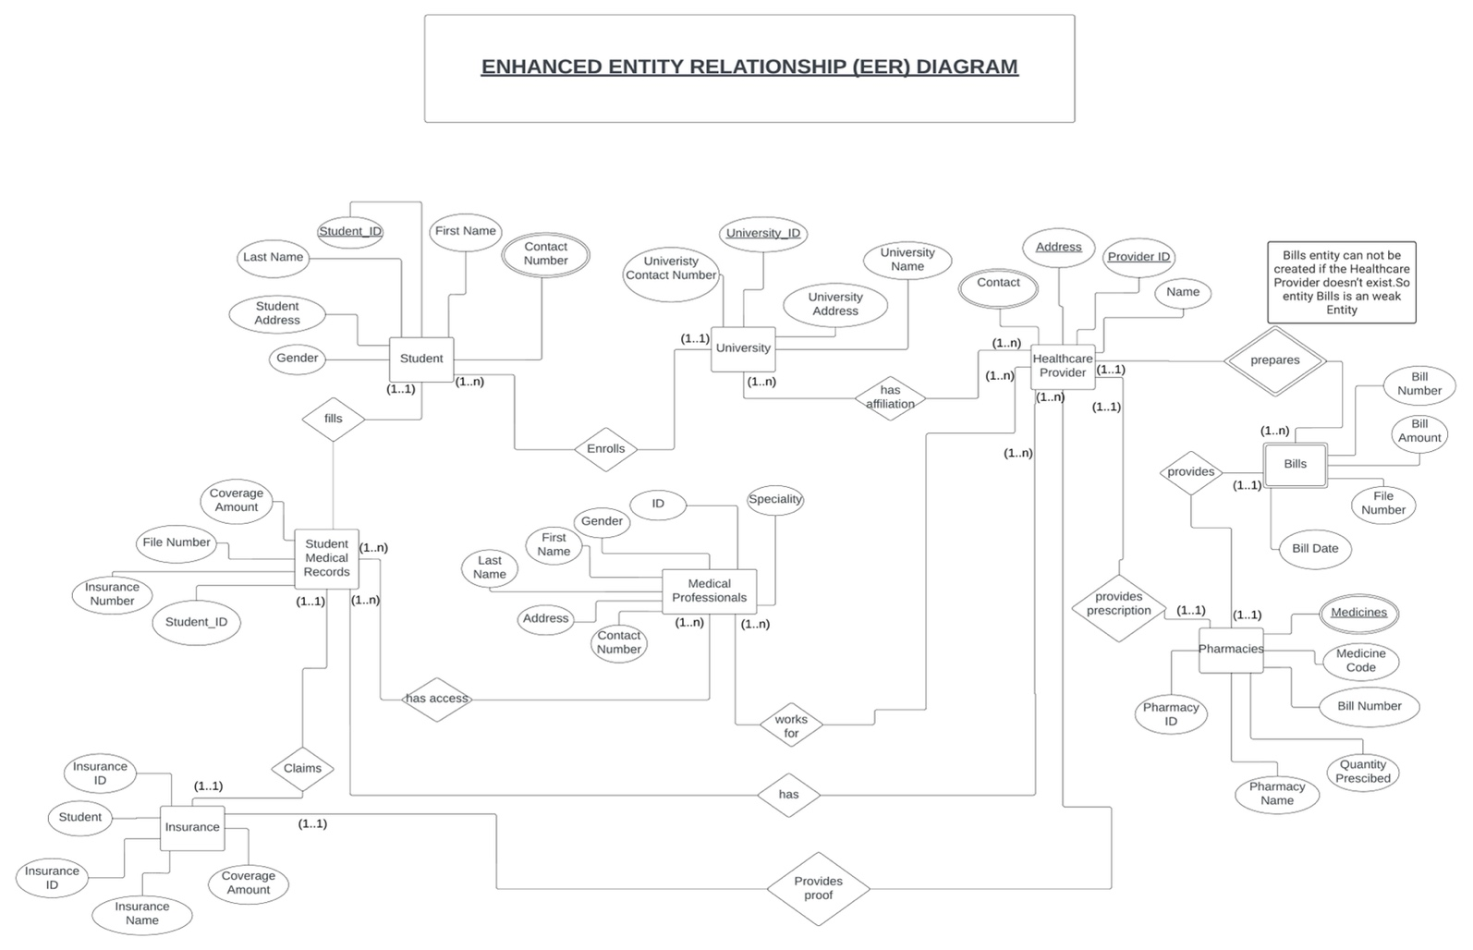
Enhanced Entity Relationship (EER) Diagram

Slide 5
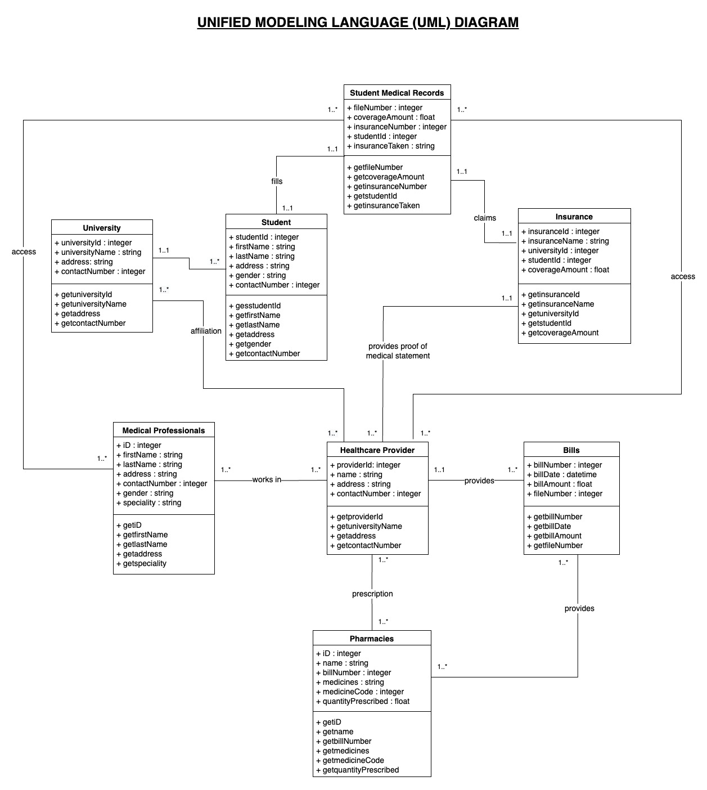
Unified Modelling Language (UML) Diagram

Slide 6
Logical Model
Student (Student_ID, First Name, Last Name, Gender, University_ID)
a. Primary Keys: - Student_ID (NULL – not allowed)
b. Foreign Keys: - University_ID
Student_Contact_Number (Student_ID, Contact Number)
Contact Number – multi-valued attribute -- decomposed into another relation
a. Primary Keys: - Student_ID, Contact Number (NULL – not allowed)
b. Foreign keys:- Student_ID
Student_Address (Student_ID, Address)
Student_Address – multi-valued attribute -- decomposed into another relation
a. Primary Keys: - Student_ID, Address (NULL – not allowed)
b. Foreign keys: - Student_ID
University (University_ID, University Name, University Address, University Contact Number, Provider_ID)
a. Primary Keys: - University_ID (NULL – not allowed)
b. Foreign Keys: - Provider_ID
Medical Professionals (MP_ID, Speciality, Gender, First Name ,Last Name ,Address, Contact Number, File_Number, Provider_ID)
a. Primary Keys: - MP_ID (NULL – not allowed)
b. Foreign Keys: - Provider_ID,File_Number
Insurance (Insurance_ID, Insurance Name, Coverage Amount)
a. Primary Keys: - Insurance_ID (NULL – not allowed)

Slide 7
Student Medical Records (File_Number, Insurance Number, Coverage Amount MP_ID, Provider_ID, Student_ID)
a. Primary Keys: - File_Number (NULL – not allowed)
b. Foreign Keys: - MP_ID, Provider_ID, Student_ID
Healthcare Provider (Provider_ID, Healthcare_Provider_Address, Healthcare_Provider_Name, Insurance_ID, File_Number, MP_ID, University_ID)
a. Primary Keys: - Provider_ID (NULL – not allowed)
b. Foreign Keys: - Insurance_ID, File_Number,MP_ID, University_ID
Healthcare Provider_Contact (Provider_ID, Healthcare_Provider_Contact)
Healthcare_Provider_Contact – multi-valued attribute -- decomposed into another relation
a. Primary Keys: - Provider_ID, Healthcare_Provider_Contact (NULL – not allowed)
b. Foreign Keys: - Provider_ID
Bills (Bill_Number, Bill_Amount, Bill_File_Number, Provider_ID)
a. Primary Keys: - Bill_Number (NULL – not allowed)
b. Foreign Keys: - Provider_ID
Pharmacies (Pharmacy_ID, Pharmacy_Name, Quantity_Prescribed, Medicine_Code, Bill_Number)
a. Primary Keys: - Pharmacy_ID (NULL – not allowed)
b. Foreign Keys: - Bill_Number
Pharmacies_Medicines (Pharmacy_ID, Medicines)
Medicines – multi-valued attribute -- decomposed into another relation
a. Primary Keys: - Pharmacy_ID, Medicines (NULL – not allowed)
b. Foreign Keys: - Pharmacy_ID

Slide 8
THANK YOU

